Slide 1
USDA Census of Agriculture 2017
Summary Report
Focus: Greenhouses and foods crops grown under cover
By Almazhan Abdukhat
Agrictecture Consulting, 2019

Slide 2
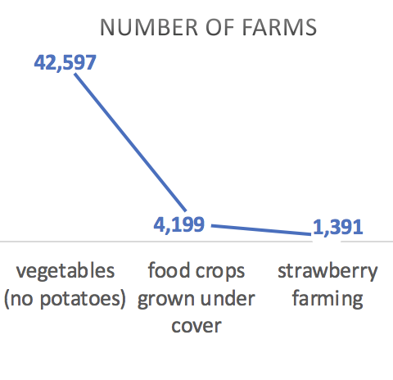
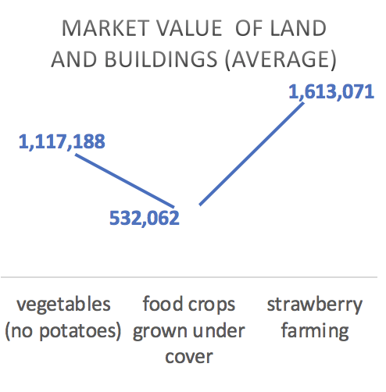
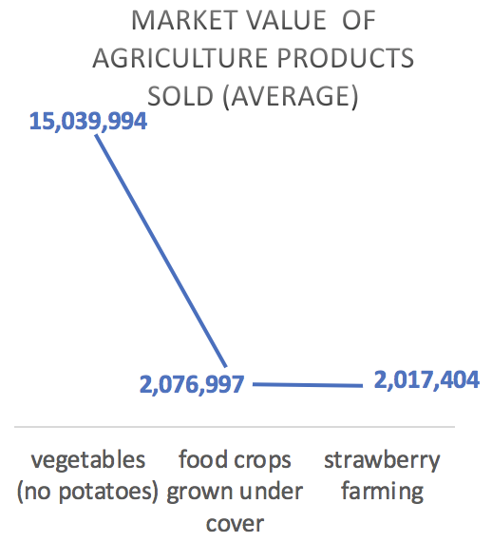
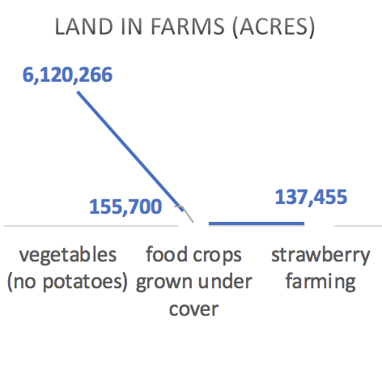
All farms: selected crops grown and their market value
Total number of farms: 2,042,220
Average Market Value of land and buildings for all farms: $1,311,808
Total Market Value of agricultural products sold for all farms: $388,522,695
Total land in farms (acres): 900,217,576
Average farm has size of 440, 8 acres
Reference: Table 48, page 59, Census of Agriculture, 2017
Notes:
Apart from crops grown under cover, one of the tasks was to consider strawberry and vegetables

Slide 3
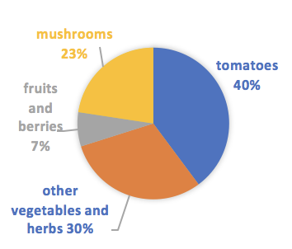
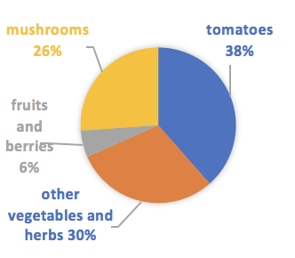
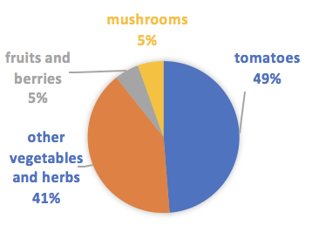
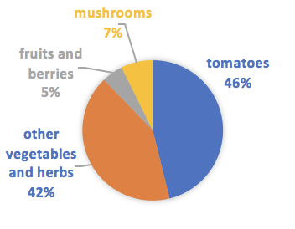
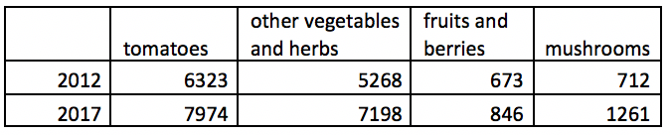
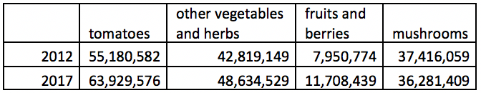
Food crops grown under glass or other protection:
2012 vs 2017
Number of farms (out of total farms) with food crops grown under glass or other protection
Area of farms (10000 sq f, out of total farms) with food crops grown under glass or other protection
VS
2012
2017
2012
2017
Although number of farms growing tomatoes decreased by 3% from 2012 to 2017 (46% vs 49%), area devoted to tomatoes increased by 2% (38% vs 40%), implying that area devoted to tomatoes increased significantly - despite that fewer farms actually were growing tomatoes
In opposite, also more farms started growing mushrooms in 2017 than in 2012 (7% vs 5%), the area devoted to mushrooms decreased by 3 % from 2012 to 2017 (26% vs 23%). Reference: Table 39, page 52, Census of Agriculture, 2017

Slide 4
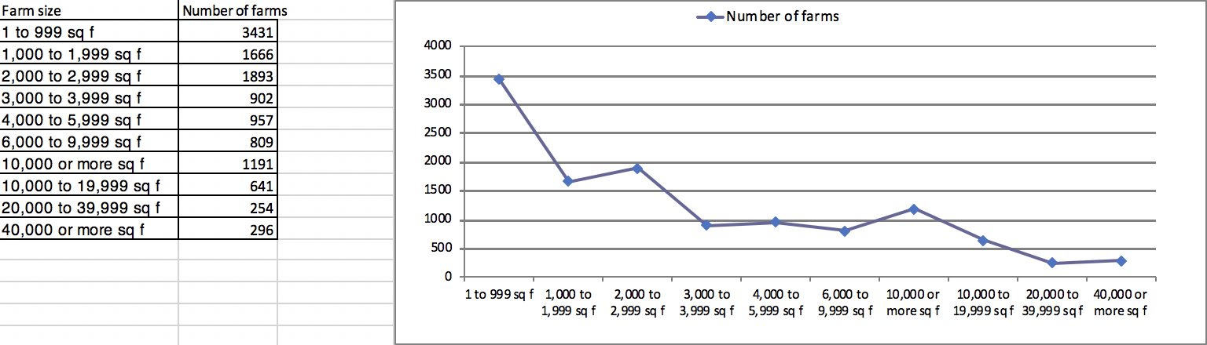
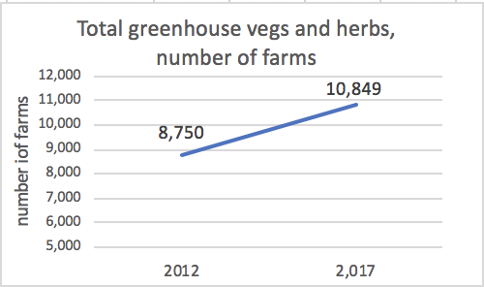
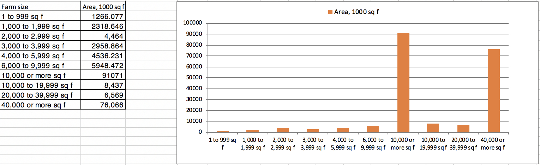
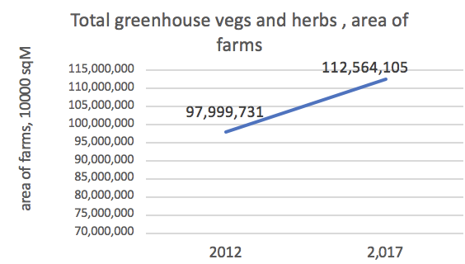
Food crops grown under protection, farm size and area: 2017
Most common farm size: 1 to 999 sq feet
Number of total greenhouses increased by 24 %
Most common farm area: 1266 thousand sq feet
Total area occupied by greenhouses increased by 14.86 %
Reference: Table 39, page 52, Census of Agriculture, 2017

Slide 5
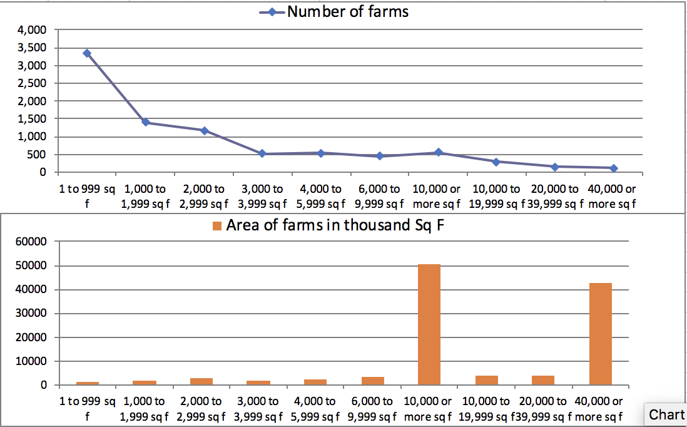
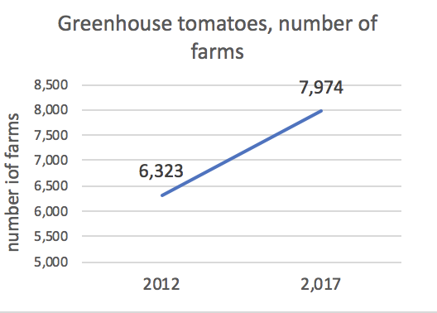
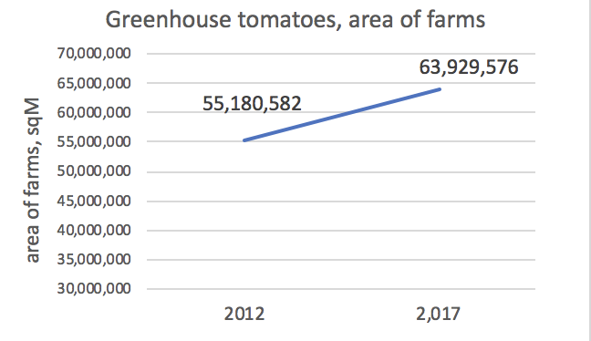
Food crops grown under protection: tomatoes
Number of greenhouses producing tomatoes increased by 26.11 % (vs 24% increase of total greenhouses)
Area of greenhouses producing tomatoes increased by 15.85 % (vs 14.86 % increase of total greenhouses)
Most common size (2017): 1 to 999 square feet
Farms with size of 10000 square feet or above have the greatest area of about 50000 square feet
Reference: Table 39, page 52, Census of Agriculture, 2017

Slide 6
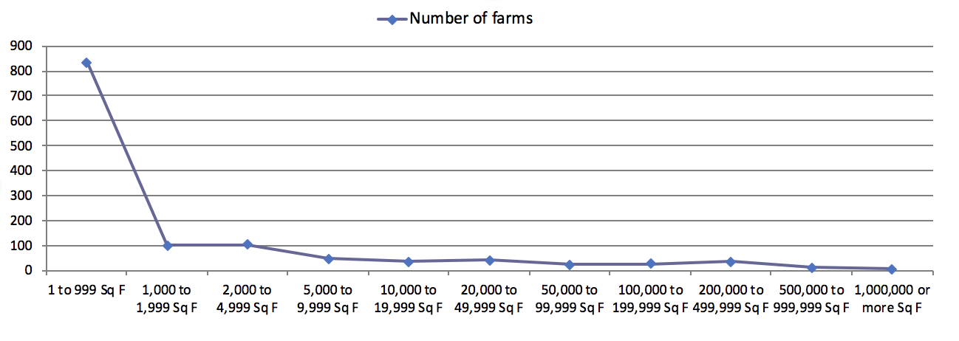
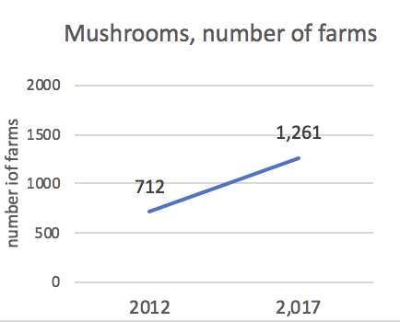
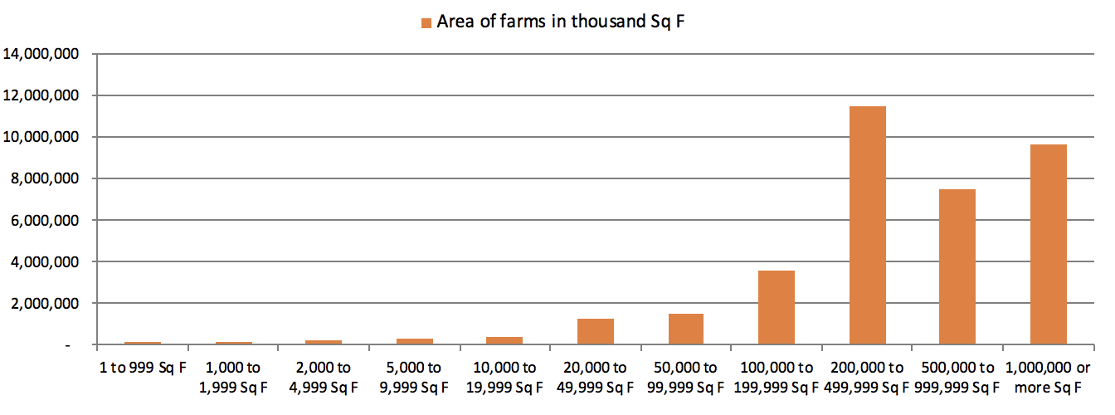
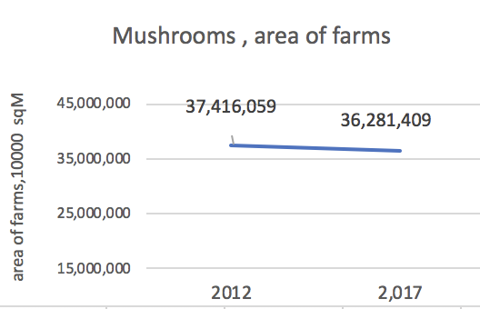
Food crops grown under protection: mushrooms
In 2017, number of farms producing mushrooms increased by 77% compared to 2012
However, despite this increase, in 2017, area of farms devoted to producing mushrooms decreased by 3% compared to 2012
Reference: Table 39, page 53, Census of Agriculture, 2017

Slide 7
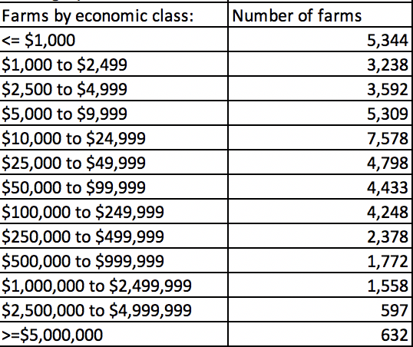
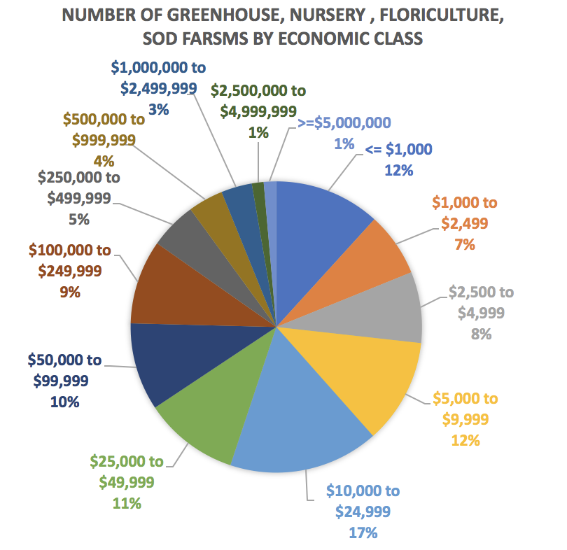
Market Value of agricultural products sold for Greenhouse, Nursery, Floriculture, Sod farms
39% of the Greenhouse, Nursery, Floriculture,Sod (GNFS) farms have market value below $9999
38% of GNFS farms have market value between $10000 and $100000
(as follows 77% of farms have mv below $100000)
4% of farms have market value above $1,000,000
Reference: Table 75, page 198, Census of Agriculture, 2017

Slide 8
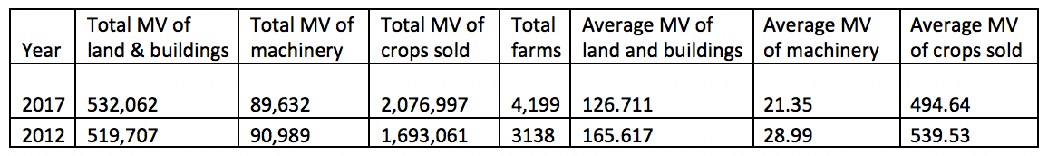
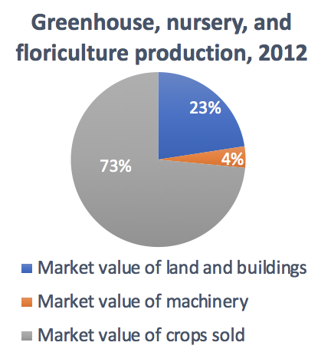
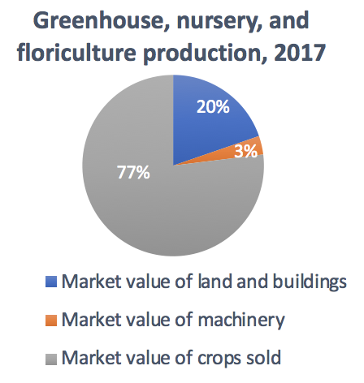
Market Value of capital assets for Greenhouse, Nursery, Floriculture, Sod farms
Although total market value of land & buildings (↑2.3%) and crops sold (↑22.67%) increased from 2012 to 2017, their average market value decreased, i.e. land & buildings (↓23.5%), crops (↓8.3%). For machinery, both total (↓1.5%) and average (↓26.35%) market value decreased from 2012 to 2017.
Among capital assets, crops sold have the highest market value
Reference: Table 48, page 69, Census of Agriculture, 2017

Slide 9
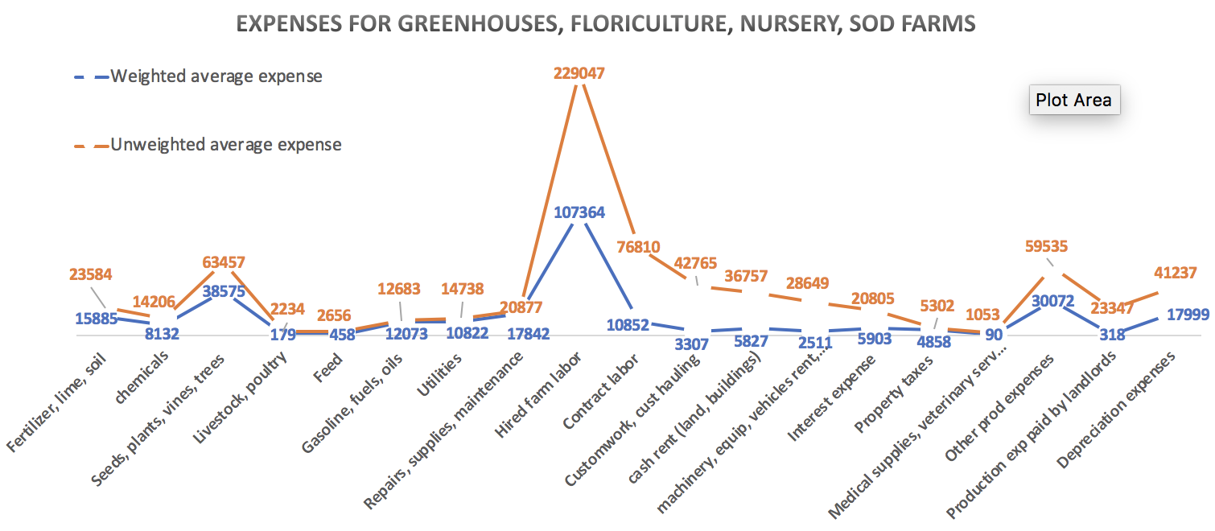
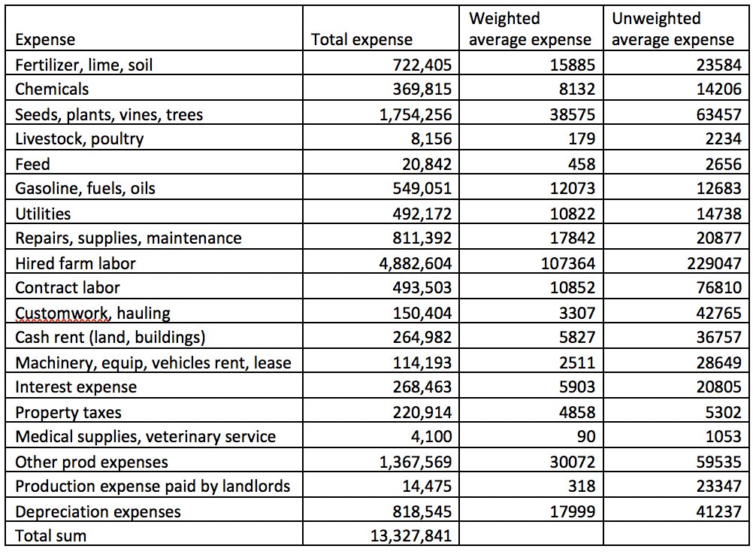
Expenses for Greenhouses, Nursery, Floriculture, Sod farms
Total farms: 45,477. Total expenses: $12,494,822. Average unweighted total expenses per farm: 274,750
The biggest average expense for Greenhouses, Nursery, Floriculture, Sod (GNFS) farms ( 21,317 farms had this expense): Hired farm labor; weighted expense: $107364; unweighted expense: $229047
Smallest average expense (3892 farms had this expense): Medical supplies, veterinary services ; weighted expense: $90; Unweighted expense:$1053;
Reference: Table 75, page 202, Census of Agriculture, 2017
Weights were calculated based on how common was the expense among all GNFS farms surveyed (45,477)

Slide 10
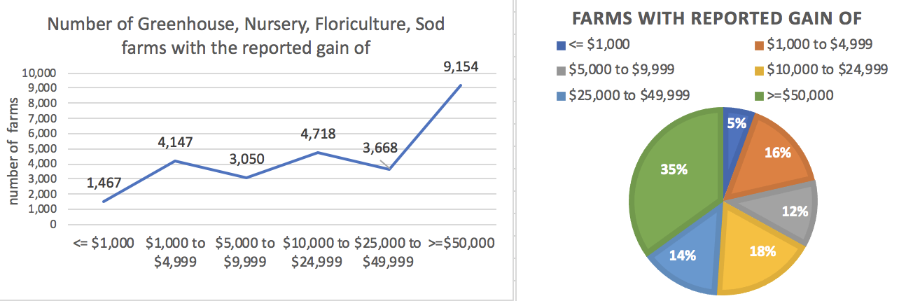
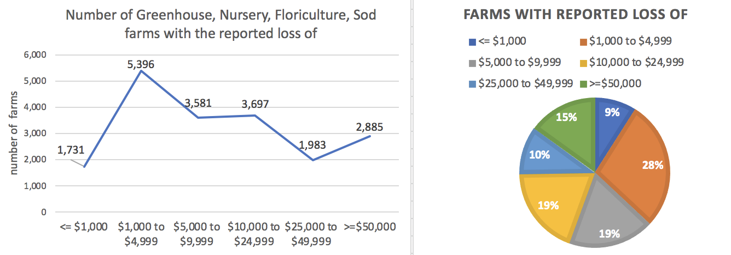
Net Gains, Loss and Net Cash Income of Greenhouses, Nursery, Floriculture, Sod farms
35% of Greenhouses, Nursery, Floriculture, Sod (GNFS) farms reported gain of greater or equal to $50000
5% of GNFS farms reported gain of less or equal to $1000
33% of GNFS farms reported gain below $10000
28% of GNFS farms reported loss of $1000 to $4999
56% of GNFS farms reported loss below $10000
15% of GNFS farms reported loss greater or equal to $50000
Reference: Table 75, page 206, Census of Agriculture, 2017

Slide 11
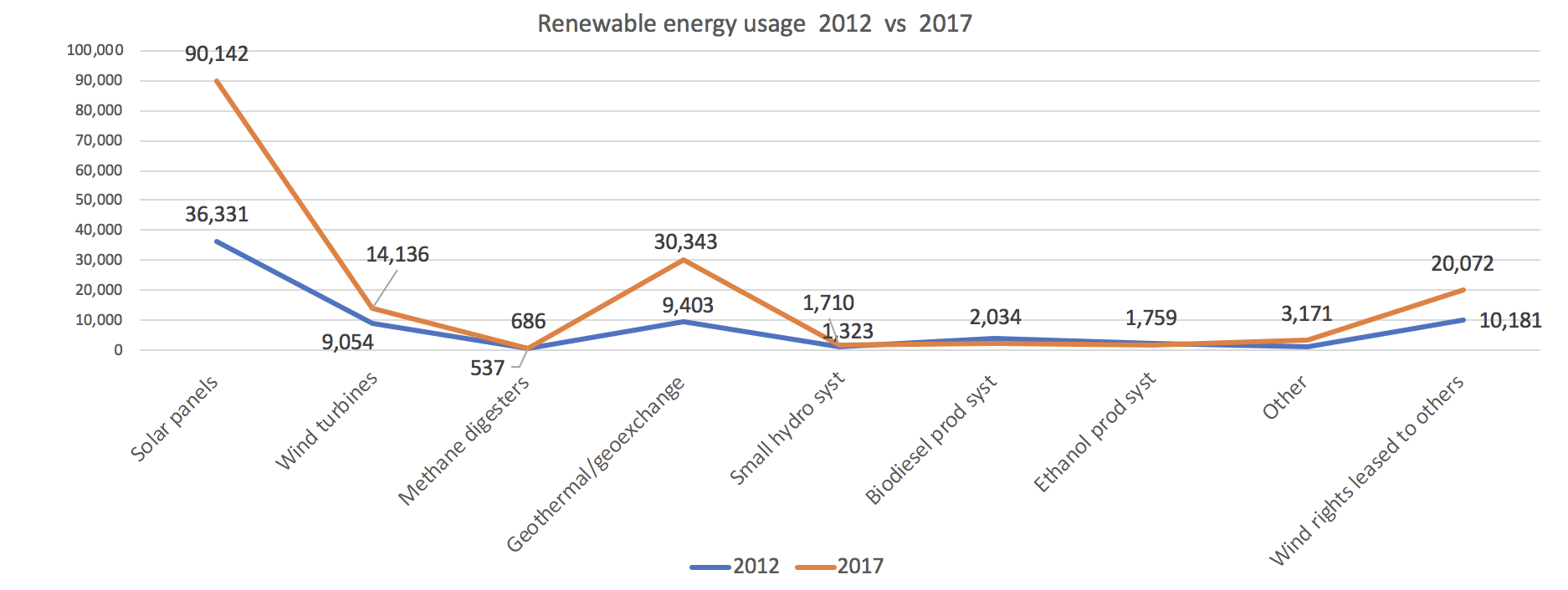
Renewable energy usage (2012 vs 2017)
Overall, in 2017 there has been a significant increase in renewable energy usage compared to 2012.
In 2017, usage of solar panels increased by 148%, usage of wind turbins increased by 56%, usage of geothermal and geoexchange systems increased by 222%, usage of small hydrosystems increased by 29%, usage of wind rights leased to others increased by 97%
Reference: Table 49, page 60, Census of Agriculture, 2017

Slide 12
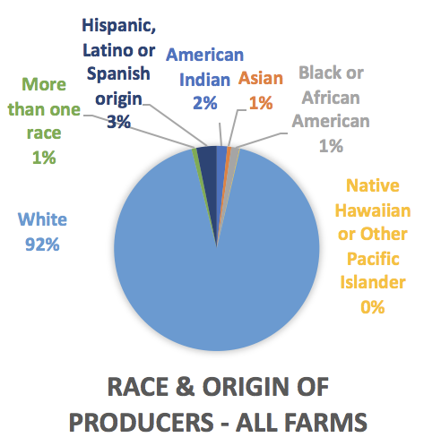
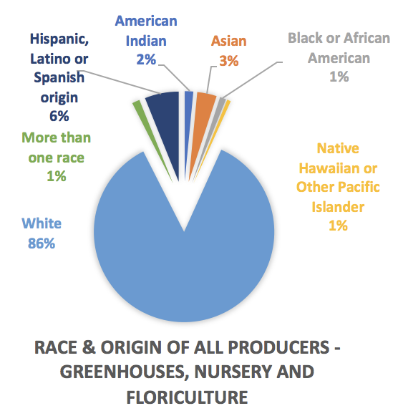
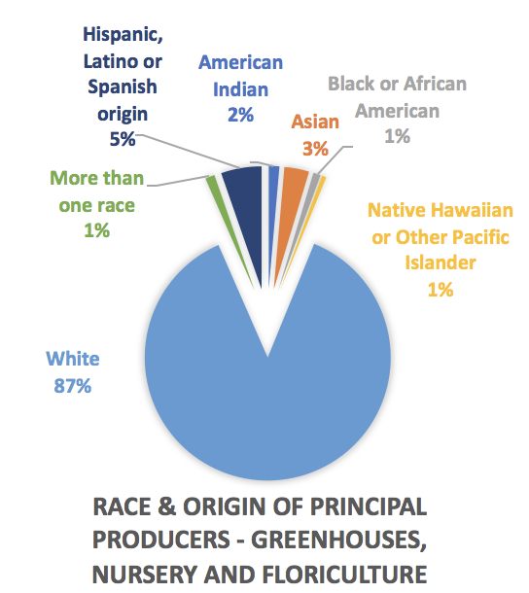
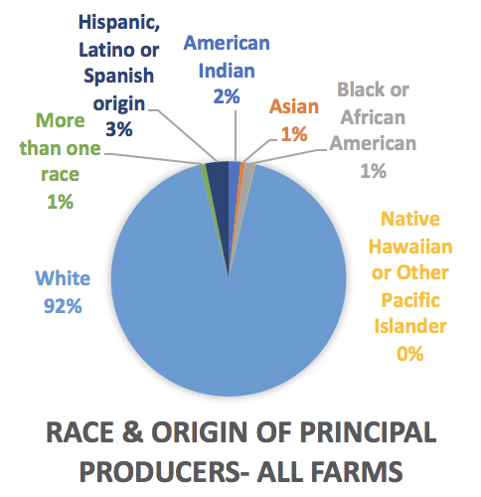
Race and origin of farmers: All Farms vs Greenhouses, Nursery, Floriculture, Sod (GNFS) farms
Fewer White farmers work in GNFS farms (86% vs 92%).
More Hispanic, Latino or farmers of Spanish origin work in GNFS farms (principal producers - 3% vs 5% and non-principal producers - 3% vs 6%)
More Asian farmers work as non-principal producers in GNFS farms (1% vs 3%)
Black farmers constitute 1% of principal and non-principal producers for both total and GNFS farms.
Similarly, for both total and GNFS farms, American Indian farmers constitute 2% of principal and non-principal farmers.
Native Hawaiian or other Pacific Islanders constitute 0.08% of principal and 0.07% of non-principal farmers for total farms. However, for GNFS farms, they constitute 1% of both principal and non-principal producers.
Reference: All farms - Tables 63-64; pages 80-83. GNFS farms: Tables 61-62; pages 72-73; Census of Agriculture

Slide 13
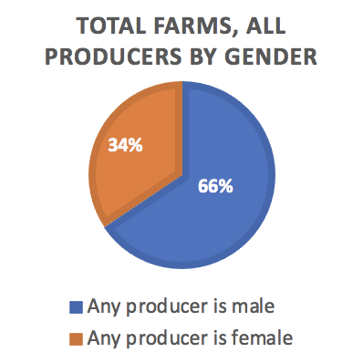
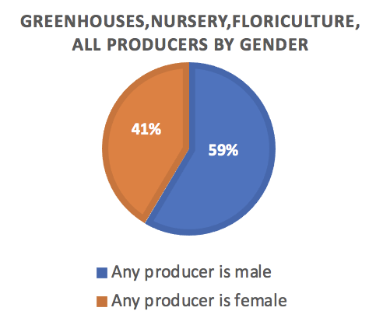
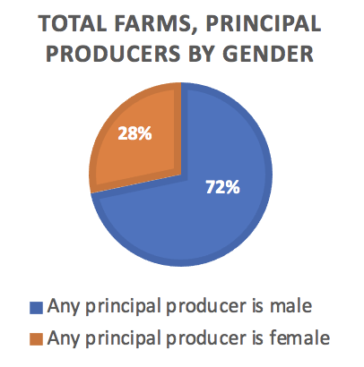
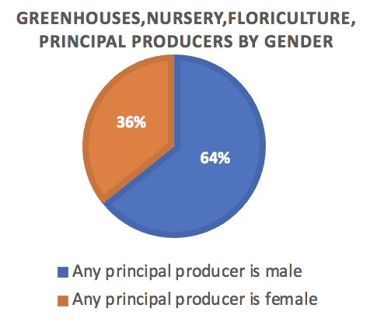
Gender of farmers: All farms vs Greenhouses, Nursery, Floriculture farms
There is a greater gender equality among all producers for Greenhouses, Nursery, Floriculture farms compared to All farms (41% vs 34% of producers are female)
Similarly, there is a greater gender equality among principal producers for Greenhouse, Nursery, Floriculture farms compared to All farms (36% vs 28% of producers are female)
For total farms, there are 2.57 times more male principal producers than female principal producers (72% vs 28%)
For Greenhouses, Nursery, Floriculture farms, there are 1.78 times more male principal producers than female principal producers (64% vs 36%)
Reference: Male producers - Table 55, page 66; Female producers - Table 57, page 68, Census of Agriculture

Slide 14
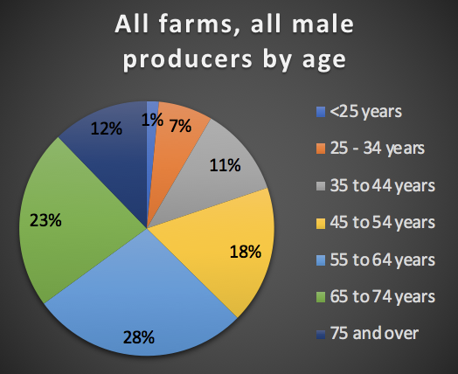
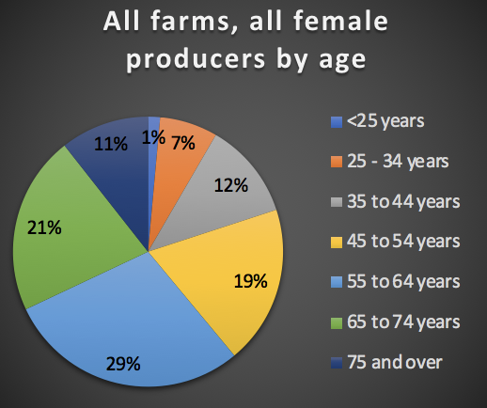
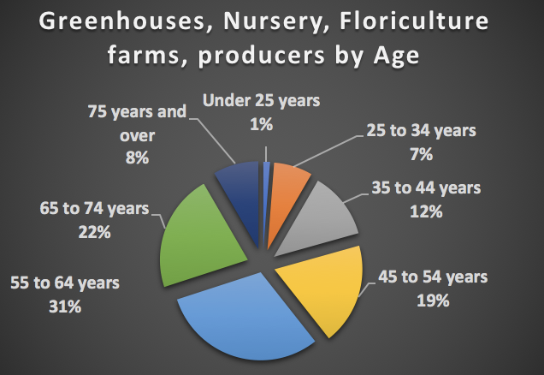
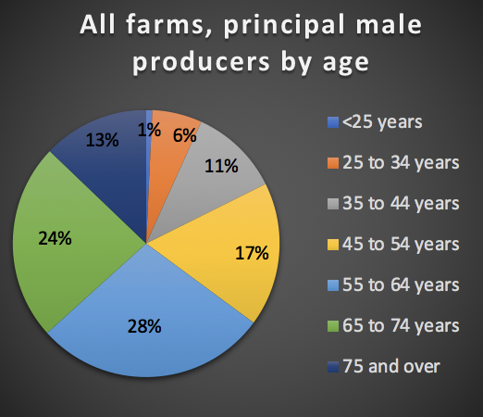
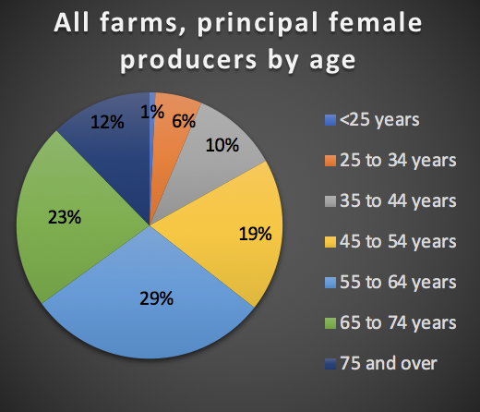
Producer’s age: All and Greenhouses, Nursery, Floriculture farms
All farms, all producers, average age: 57.5
All farms, all principal producers, average age: 58.6
Greenhouses, Nursery, Floriculture, average age: 56.5
Producer age statistics:
Most farmers (both genders) are between 55 to 64 years old
Age below 44: all producers: 20% female, 19% male;
principal producers: 17% female, 18% male;
Age above 65: all producers: 32% female, 35% male;
principal producers: 35% female, 37% male.
Female producers, both principal and non-principal, tend to be younger
Reference: Greenhouses, Nursery, Floriculture- Table 75, page 214;
Male producers - Table 56, page 67; Female producers - Table 58, page 69; Census of Agriculture

Slide 15
Thank you for your attention!
USDA Census of Agriculture: https://www.nass.usda.gov/Publications/AgCensus/2017/#full_report

